Slide 1
Sass
Syntactically Awesome Style Sheets

Slide 2

If you ask me if I think CSS pre-processors are worth learning, incorporating into your workflow, and what my favourite is, I'd tell you: yes, yes, and Sass with Compass. - Chris Coyier -

Slide 3
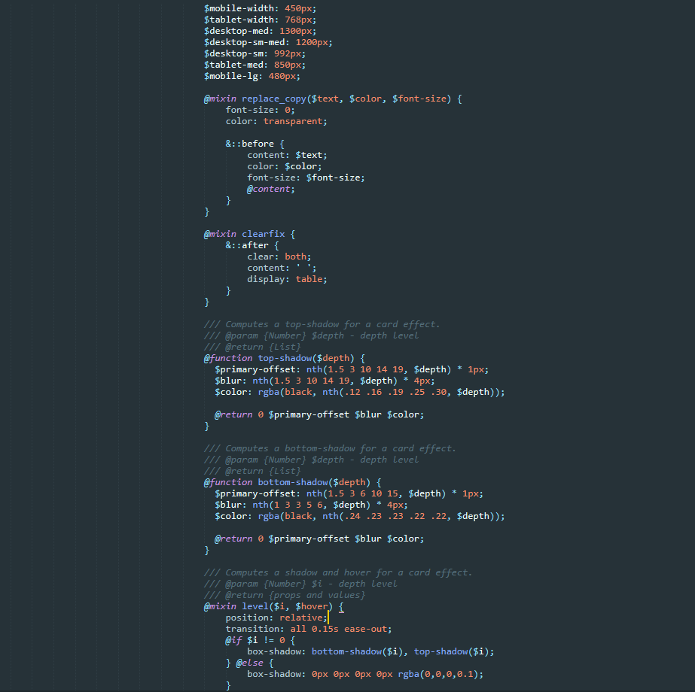
What is Sass?
CSS with superpowers – Sass Team

Slide 4
What is it?
Sass is the most mature, stable, and powerful professional grade CSS extension language in the world.
CSS Compatible
Sass is completely compatible with all versions of CSS, allowing you to seamlessly use any available CSS libraries.
Feature Rich
Sass boasts more features and abilities than any other CSS extension language out there.
Mature
Sass has been actively supported for over 12 years!
Industry Approved
Sass has steadily become an industry standard with many job specs listing Sass as either a desirable skill or requirement of the role.

Slide 5
Preprocessing

Slide 6
How do I use it?
Sass is the most mature, stable, and powerful professional grade CSS extension language in the world.
CSS Compatible
Sass is completely compatible with all versions of CSS, allowing you to seamlessly use any available CSS libraries.
Feature Rich
Sass boasts more features and abilities than any other CSS extension language out there.
Mature
Sass has been actively supported for over 12 years!
Industry Approved
Sass has steadily become an industry standard with many job specs listing Sass as either a desirable skill or requirement of the role.

Slide 7
Nesting

Slide 8
Variables

Slide 9
Operators

Slide 10
Mixins

Slide 11
Partials

Slide 12
Conditionals & Loops

Slide 13
Extend/Inheritance

Slide 14
Best Practices

